Slide 1
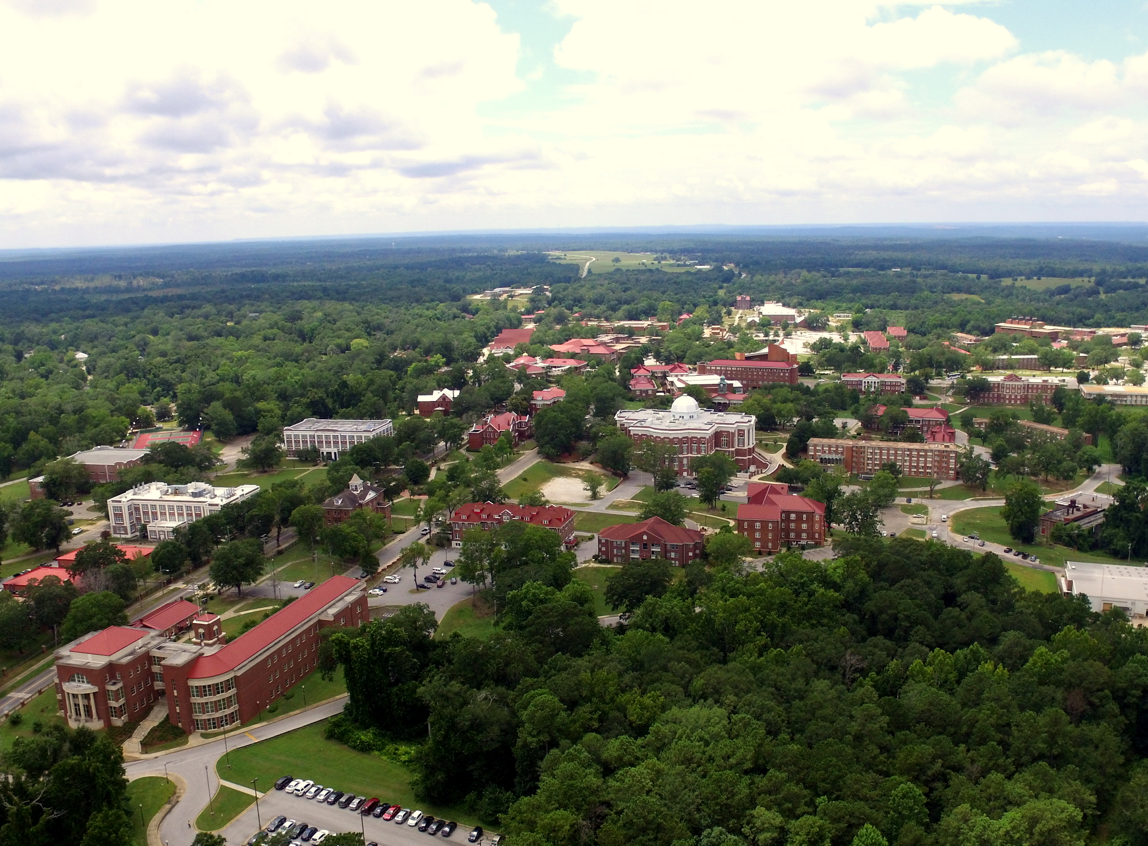
On Behalf Of
Tuskegee University’s STUDENT FINANCIAL SERVICES
Welcome To New Student Orientation
Christy gaskin, interim executive director

Slide 2

🎓 Money Matters, But So Do You!​
Welcome, Golden Tigers!​
​
​
We’re here to help you secure the bag!
🐅

Slide 3
Meet Your Financial Aid Team
We’re not magicians, but we do make money appear (sometimes)
COUNSELOR’S CONTACT INFORMATION
A-H KIMBER HOLMES kholmes@tuskegee.edu
I-Q MIA HARRIS mharris@tuskegee.edu
R-Z GWENDOLYN JOHNSON gjohnson@tuskegee.edu

Slide 4
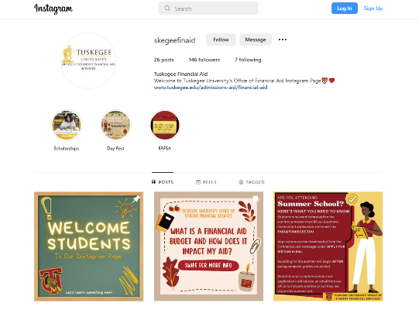
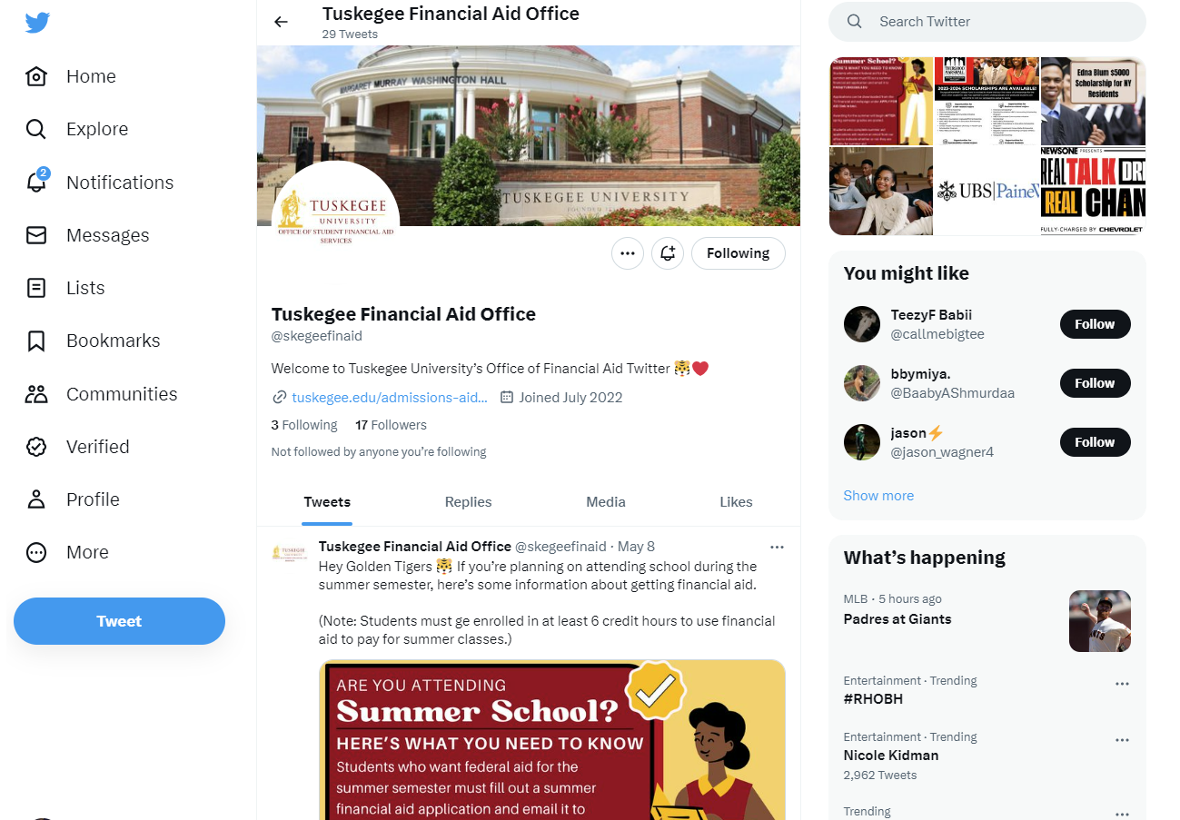
Social Media Pages @skegeefinaid

Slide 5
Stay In The Know
-Check Tiger Web regularly
-Respond to emails from Financial Aid
-Follow TU social media for deadline reminders & tips

Slide 6
Top 5 Financial Aid Fails 🚫
Let’s Not Be That Student:
1. Ignoring emails
2. Missing FAFSA deadlines
3. Failing SAP
4. Not checking Self Service
5. Expecting refunds Day 1 (😅 lol no)

Slide 7
FAFSA – Your Golden Ticket 🎫
Complete it every year at studentaid.gov
Tuskegee’s FAFSA Code: 001050
Priority Deadline: April 1st
Pro tip: Don’t wait - remind them early!

Slide 8
TYPES OF AID
Federal Pell Grant – based on need
SEOG – extra funds for need-based students
Loans - subsidized (interest awaits) unsubsidized (interest starts immediately)
Parent Plus Loans – for your parents .... SURPRISE mom & dad!
Federal Work-Study – earn $ while studying
External Scholarships - more $$$
Private Loans

Slide 9
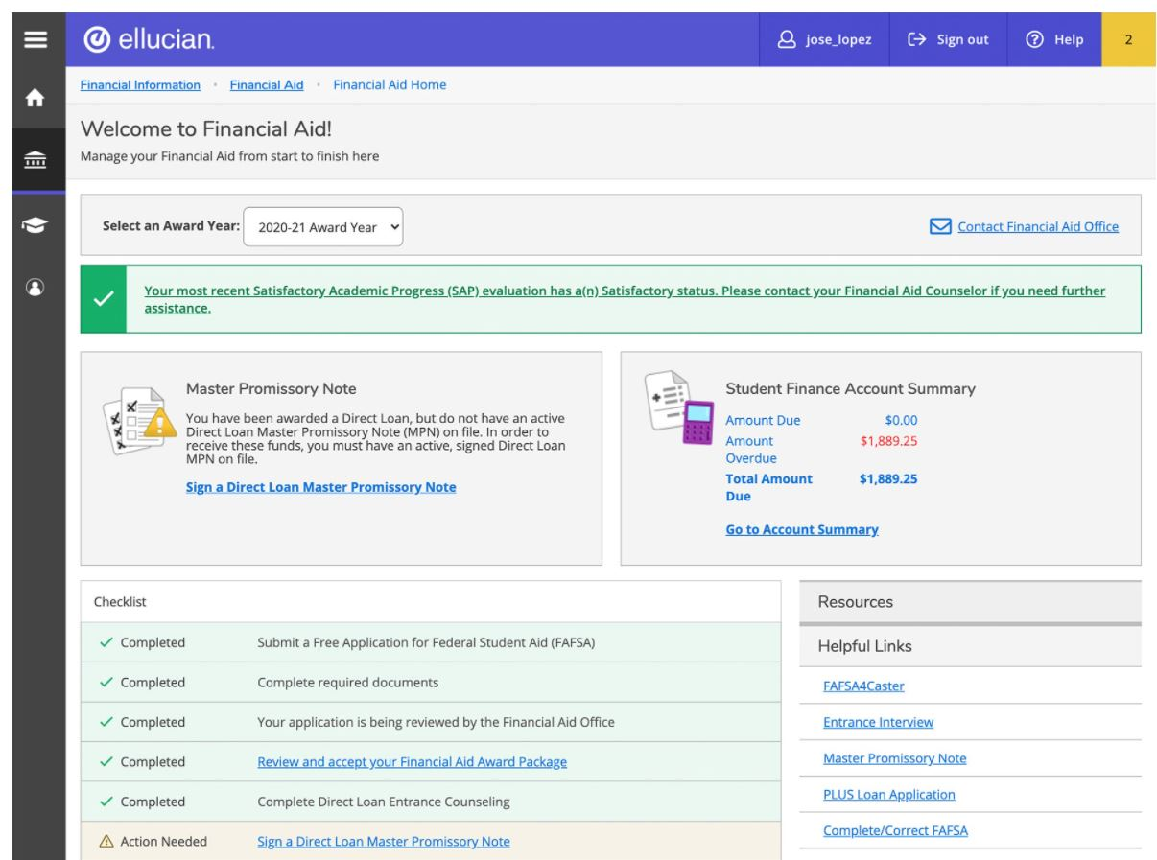
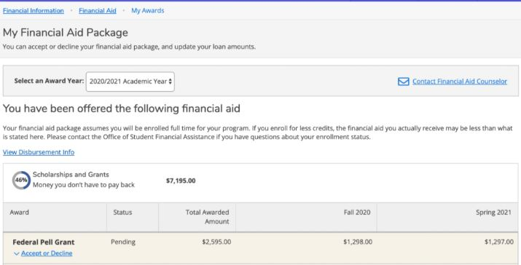
How To Accept Award

Slide 10
Loan Requirements
Entrance Counseling 🎥 = Financial Netflix, but Useful
Entrance counseling teaches you the real-life stuff you didn’t learn in high school—like how loans work, how interest sneaks up, and why it’s okay to say “I’ll just borrow what I need.”
Master Promissory Note (MPN) 🖋️ It's Like Signing a Deal With Your Future Self
Completing the Master Promissory Note (MPN) is like signing a contract with your future—you’re agreeing to pay back your loans once you graduate. It’s a serious step, but it also means you're officially investing in you.
🚫 No MPN = No Money
You can’t receive federal loans without completing the MPN. It’s like showing up to a concert without a ticket—you won’t get in, no matter how good your outfit is.
Take at least 6 credit hours 📚 You Gotta Be a Half-Timer
To qualify for federal loans, you need to be enrolled in at least 6 credit hours—that’s usually 2 classes or more. Less than that, and your financial aid might say “bye for now.” 😬

Slide 11
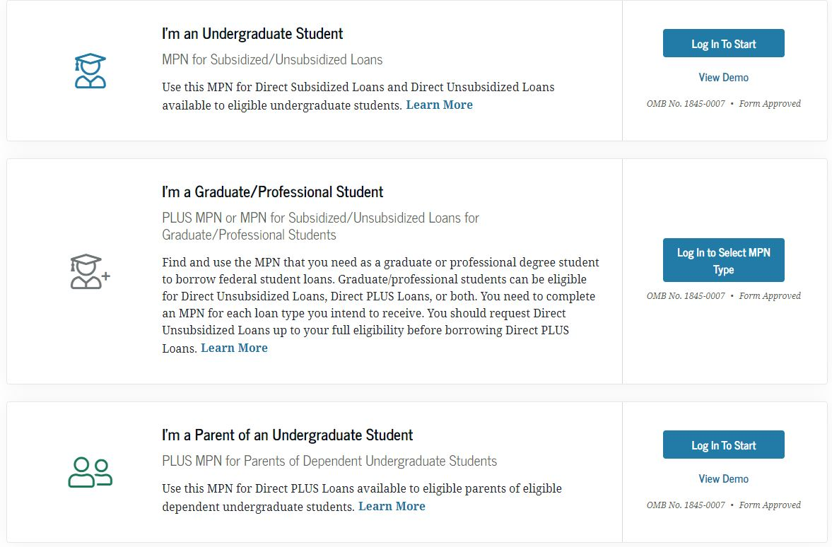

Slide 12
Federal Work-Study
Federal Work-Study lets you earn money through part-time campus or community jobs while you’re in school 🎓💸so you can build your résumé and your bank account at the same time.
It’s like a “student job with benefits”:
✅ Flexible hours that work around your class schedule
✅ Real-world experience (great for future job apps!)
✅ And yes, you get a paycheck—not just a loan!
Get paid on the 14th of each month!
Federal Work Study Portal Opens Will Open September 1, 2024.

Slide 13
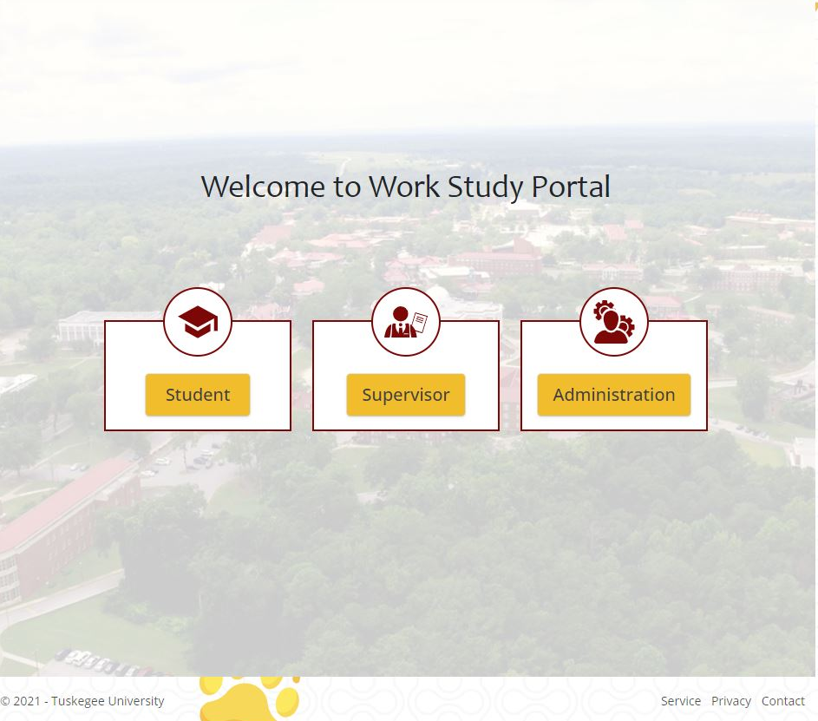
Federal Work-Study

Slide 14
SCHOLARSHIP OPPORTUNITIES:
HTTPS://WWW.TUSKEGEE.EDU/PROGRAMS-COURSES/SCHOLARSHIPS
UNCF- www.uncf.org
THRUGOOD MARSHALL- www.tmcf.org
**Thousands of Dollars Go Unclaimed Each Year
UNCF and TMCF offer millions in scholarships annually—but many go unclaimed because students don’t apply. That could be your free money just sitting there!

Slide 15
Credit Balance
The institutional financial aid award shall not result in a credit balance to the student when combined with other scholarship/grant offers. Institutional financial aid will be reduced per academic year if any external scholarship/grant award creates a credit balance for the student. I FURTHER UNDERSTAND THAT IF MY AWARD CONSISTS OF ONLY GRANTS, EXTERNAL OR INSTITUTIONAL SCHOLARSHIPS, I AM NOT ELIGIBLE FOR A CREDIT BALANCE.

Slide 16
You Can’t Get a “Cash Back” Bonus from Scholarships
If all your aid—like grants, scholarships, and institutional awards—adds up to more than what you owe for tuition, housing, and fees, don’t expect a refund check. 🛑💸
👉 If your institutional aid + external scholarships create a credit balance, your school will reduce the institutional aid so that it just covers your costs—not more.

Slide 17
Maintaining Eligibility
👀 Yes, we’re watching your grades!
Students must maintain Satisfactory Academic Progress (SAP)
Students must maintain a 2.0 cumulative GPA
Students are required to complete at least 75% of all attempted credits
Students must not exceed maximum timeframe for degree objective
Finish your degree in a reasonable timeframe
Falling behind = losing aid

Slide 18
We Are Here to Serve You Remotely
If you have additional questions about any topic covered in this presentation, you may contact a financial aid team member.
Email: finaid@tuskegee.edu
Phone: (334) 727-8088
Book an appointment: https://outlook.office365.com/owa/calendar/TuskegeeUniversityStudentFinancialServices@tuskegee.onmicrosoft.com/bookings/

Slide 19
You Got This, Golden Tiger! 🐅
Financial aid doesn’t have to be scary!
Stay organized
Ask questions (there is no stupid question, only if do not ask)
Check your email
We’re rooting for you—yes, even when you forget a form 😉

Slide 20


