Slide 1
Website Accessibility Guidelines
Understanding WCAG 2.0
Presented by: Cassandra P. Cooper, MS-ISSM
Tuskegee University Webmaster/Web Content Specialist
Tuskegee University Office of Communications, Public Relations and Marketing

Slide 2
Overview
In creating a website that works for anyone, it has to be accessible to everyone---including people with disabilities.
Every institution that receives Federal Financial Aid is required to make reasonable accommodations to make their web content accessible.
The World Wide Web Consortium (W3C) makes recommendations and guidelines for making web content more accessible.
Following these guidelines helps make our web content accessible to more people with various types of disabilities.
Web Content Accessibility Guidelines (WCAG) 2.0 covers a wide range of recommendations for making Web content more accessible.

Slide 3
WCAG 2.0 Guidelines – Four Principles
Principle 1: Perceivable - Information and user interface components must be presentable to users in ways they can perceive.
Principle 2: Operable - User interface components and navigation must be operable.
Principle 3: Understandable - Information and the operation of user interface must be understandable.
Principle 4: Robust - Content must be robust enough that it can be interpreted reliably by a wide range of user agents, including assistive technologies.

Slide 4

Types of Disabilities
For people with disabilities, operating a keyboard, mouse or monitor may be difficult or impossible. Types of disabilities include:
    Hearing (people who cannot hear sounds from our webpage)
    Physical (people with motor disabilities)
    Speech and Cognition (people who need help
    reasoning or pulling information)
    Vision (blind people or people with very low sight)

Slide 5
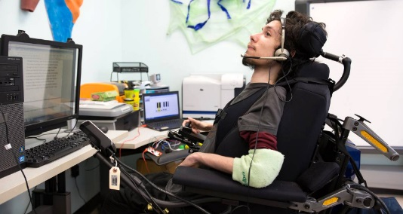
Solutions
Devices and services called “assistive technologies” have been developed to assist users with special needs
Hearing -- Closed captioning, transcripts, haptic alerts, video relay services
Physical – Special keyboards, wands, sip and puff switches, switch control, joysticks, trackballs, head pointers.
Speech and Cognition -- Mobile devices with text-to-speech software, Siri, guide apps such as Magnus Mode
Vision -- Screen readers. Screen magnifiers, speech
recognition software, refreshable braille displays

Slide 6
Accessibility Audit
Test your webpages with an automated accessibility checker.
These tests help identify accessibility issues.
Even though these tests don’t identify 100% of the accessibility issues, it still helps.
Use the CMS built-in Accessibility Checker
Use student workers to test our website for accessibility
Or even better, use a disabled person to test our website for accessibility

Slide 7
What does “checking” test for?
Checks all images to make sure they have alternative text.
Checks that all form fields have labels.
Checks that all color combinations and text are used appropriately.
Checks that all links are working like they are supposed to.
Checks for titles, headings and header rows on tables.
…and it checks for other accessibility issues.

Slide 8
Accessibility-related Features on TU Website
On the Public Side:
  The ability to Enlarge the font size
  There is a Share feature that can send the webpage to Platforms such as Facebook or Google that have assistive technologies
  The content is Reactive so that it displays to fit whatever device it is viewed on
On the Content Editor Side:
  There's an Accessibility Checker built into the CMS editor that points out the issue and gives a possible solution
  The ability to add Alternative Text and Caption for all uploaded images or pictures
  Table properties allow the content editor to add Row or Column Headers and Caption
  Ability to write Languages LTR or RTL
  Ability to add SEO Descriptions and Keywords for posted content

Slide 9

Wrap-up
Accessibility is a process
Content Editors should follow our university’s Accessibility Guidelines
Get Work-study Students or even an Alum to help check our webpages for accessibility
Short ALT text should be added to all uploaded images
Please use headings and header rows to help label content
Remember to check our webpages for accessibility
before you activate it

Slide 10
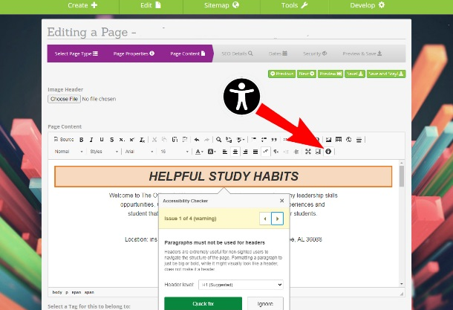
Q & A and Comments
This image shows the Accessibility Checker on the TU website’s Innovate CMS editor.

