Slide 1
Internet Security
An Introduction to Phishing and Viruses

Slide 2
What is Internet Security?
The internet is a dangerous area that is open to all users to exchange information without protection and is prone to attacks like viruses, worms, Trojan horses, etc.
The purpose of internet security is to create rules for users to follow to have a safe browsing experience.

Slide 3
Examples of Malware
Viruses - programs that can replicate their structures by infecting other files on a computer. Commonly used to take over a system and steal data (usernames, passwords, etc.)
Worms – programs that replicate themselves through a computer and damage its structure

Slide 4
Examples of Malware (cont.)
Trojan Horse – a program that appears friendly, sometimes hiding inside a commonly downloaded program, attacks a system after it is downloaded
Spyware – a program that monitors user activity and reports it to other parties without user consent

Slide 5
Intro to Phishing
“Phishing” is defined as the attempt to acquire sensitive information (username, password, credit cards) by posing as a trustworthy party.
The surge of social media pages (Facebook, Twitter, Instagram) has made it much easier for hackers to find user information and steal that information.

Slide 6
How to Spot Phishing
Many phishing scams come in the form of emails.
These letters will appear to be from a reliable source (a bank, a social media account) and will have a link that also looks legitimate
This link will direct the user to the website where they entre personal information that is sent to the dangerous source

Slide 7
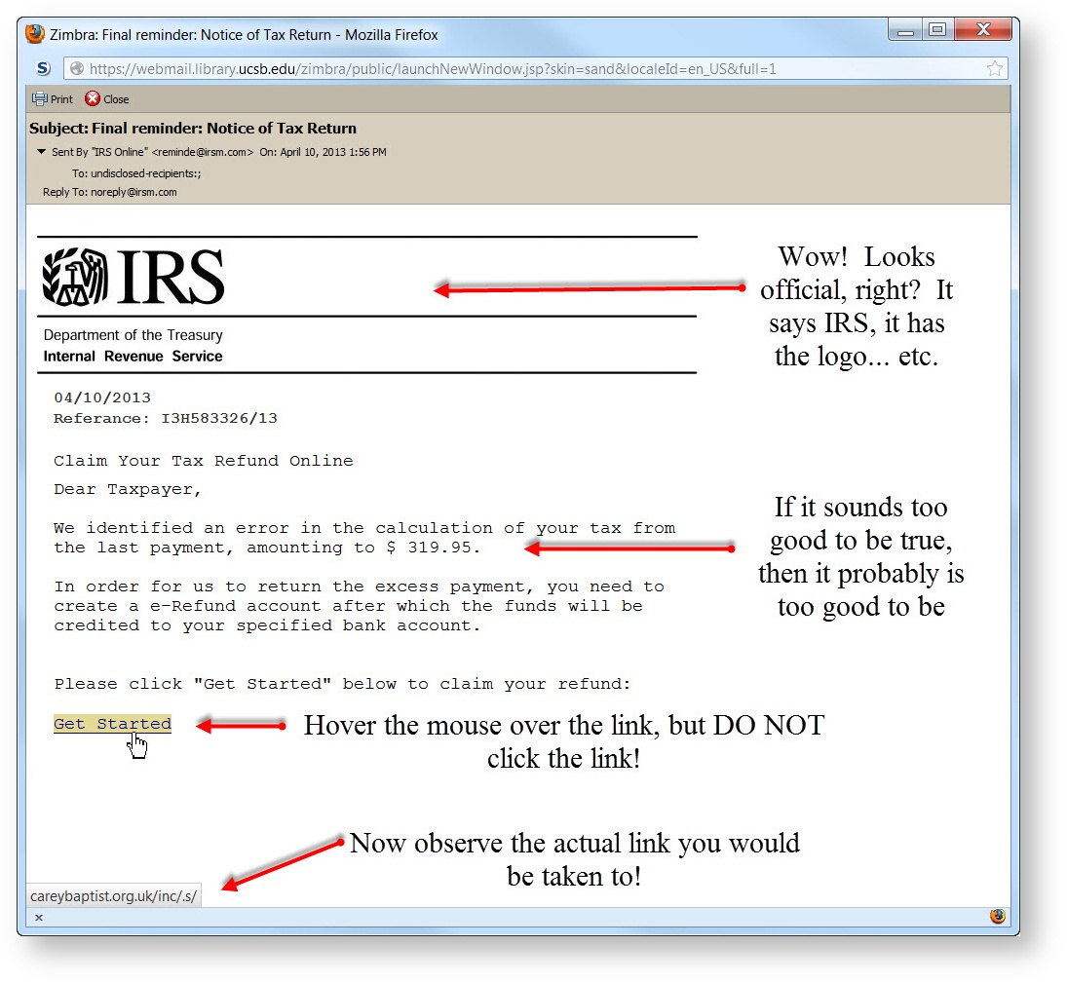
How to Spot Phishing (cont.)
There are a few tips and tricks that you can use to avoid the scams

Slide 8
How to Avoid Phishing
Check for random or careless misspellings in the email
Remember who is supposed to be sending the email (if the school is mailing you, they would not ask for a username and password)
Check the link before clicking (hover the cursor over the link and see if the address at the bottom of the screen matches the link)

Slide 9
Lets See it in Action
This is a demo of an actual phishing site that was live for a while, but has fortunately been removed
https://www.youtube.com/watch?v=D54nTfLhRr4

Slide 10
Introduction to Trojan Horses
A Trojan Horse is usually a non-self-replicating program that contains dangerous code
This code, depending on the nature of the program, can cause loss or theft of data stored on the system

Slide 11
How do They Work?
Trojan Horses disguise themselves in routine updates or seemingly harmless downloads
Once they have been introduced to a new system they act as a sort of “backdoor”
The program will contact a distant controller once it has unauthorized access to the affected computer

Slide 12
Here is an Example
Trojan Horses are not just limited to laptops and desktop computers.
Here is a demo of a simple Trojan Horse that could be in your phone.
https://www.youtube.com/watch?v=eEcz0XszEic

Slide 13
What did you learn?

Slide 14
Question #1
What are three types of malware and what do they do?

Slide 15
Question #2
What is the most common way for someone to become a victim of phishing scam/How to hackers trick users?

Slide 16
Question #3
How can you avoid phishing scams?

